Slide 1
Fortify
SAP ABAP Scanning with Fortify
29 01 2025
|
Rajesh Kumar

Slide 2
Fortify ABAP – What’s New
Fortify Static Code Analyzer version 24.4 supports ABAP Platform 2023 / ABAP 7.58
The support includes S/4 HANA.
Version 24.4 also improves our support for the older ABAP 6 version
Minor limitation: data flows through “table types”, “REDUCE” operator not yet supported.
Notes:
https://www.microfocus.com/en-us/assets/cyberres/magic-quadrant-for-application-security-testing

Slide 3
Fortify ABAP – Latest Rule pack
Fortify Software Security Content Update 25.1 - Fortify Tips - OpenText Fortify
ABAP (Advanced Business Application Programming) is SAP’s primary programming language for developing robust business applications within the SAP ecosystem. It supports both procedural and object-oriented paradigms, integrates seamlessly with SAP’s data and application frameworks, and underpins a wide range of enterprise-level solutions. Improvements to category coverage span 11 existing categories and adds support for the following categories in ABAP applications:
25.1
Denial of Service: Regular Expression
Insecure Transport
Missing XML Validation
Path Manipulation: Zip Entry Overwrite
Server-Side Request Forgery
Setting Manipulation
Unreleased Resource: Database
Unreleased Resource: Sockets
XML Entity Expansion Injection
XML External Entity Injection
XML Injection
Notes:
https://www.microfocus.com/en-us/assets/cyberres/magic-quadrant-for-application-security-testing

Slide 4
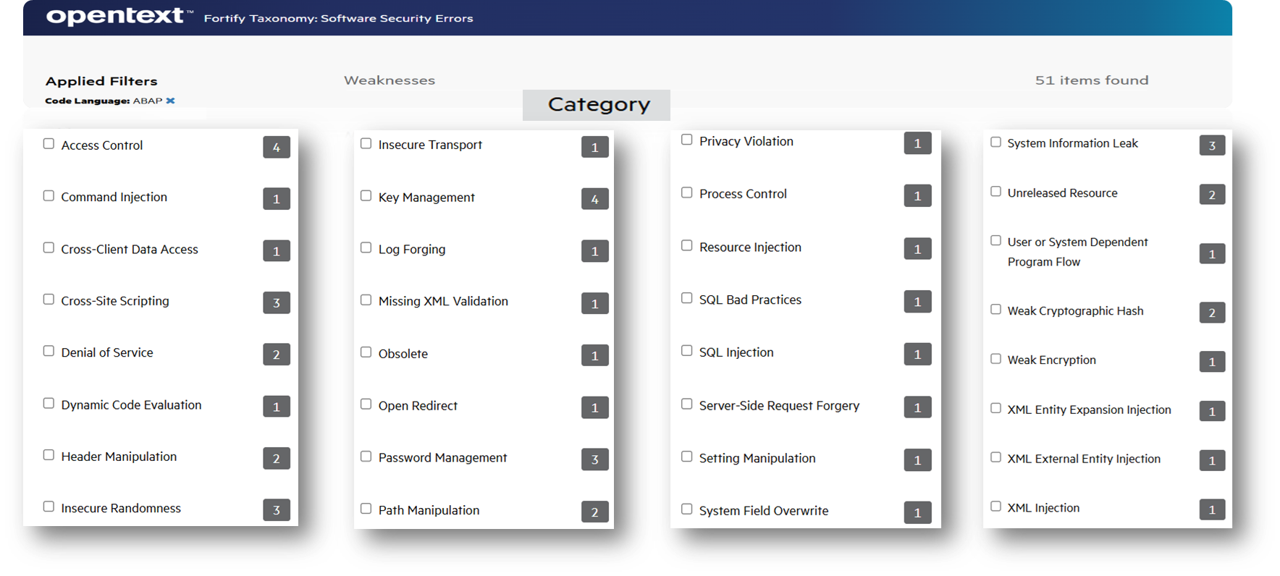
Fortify Scan ABAP – Coverage
Fortify has a comprehensive set of rules for finding vulnerabilities in SAP ABAP Code (see https://vulncat.fortify.com/en/weakness?codelang=ABAP for some examples).
Notes:
https://www.microfocus.com/en-us/assets/cyberres/magic-quadrant-for-application-security-testing

Slide 5
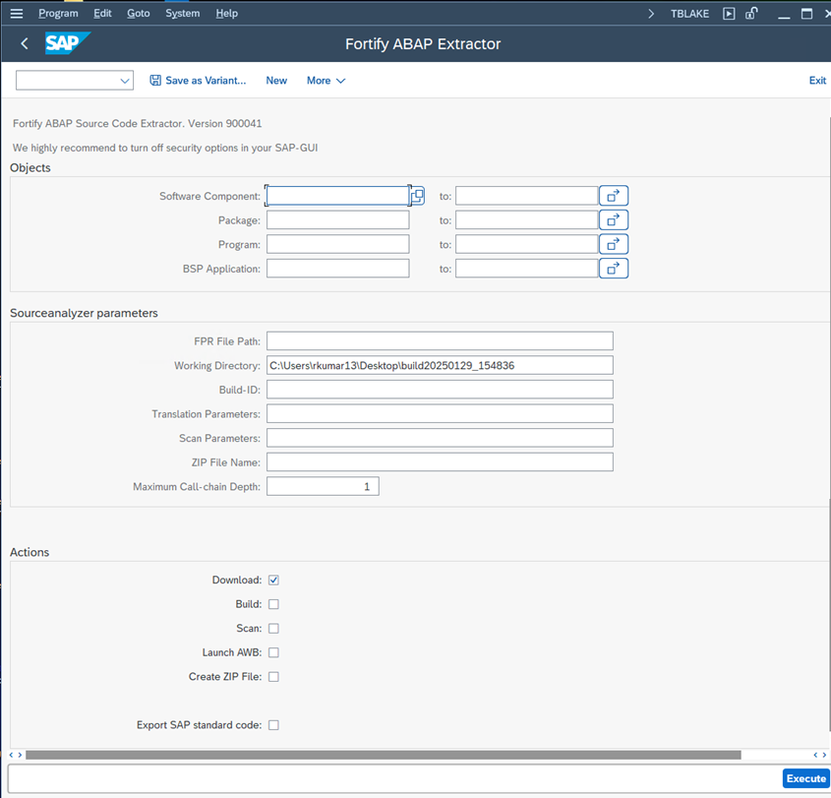
Fortify Scan ABAP –Extractor
The Fortify ABAP Extractor automates the process of extracting SAP ABAP Program code and scanning for vulnerabilities.
ABAP Extractor – Various Options
https://www.microfocus.com/documentation/fortify-static-code-analyzer-and-tools/2440/SCA_Help_24.4.0/index.htm#abap/RunABAPExtractor.htm?Highlight=ABAP
Notes:
https://www.microfocus.com/en-us/assets/cyberres/magic-quadrant-for-application-security-testing

Slide 6
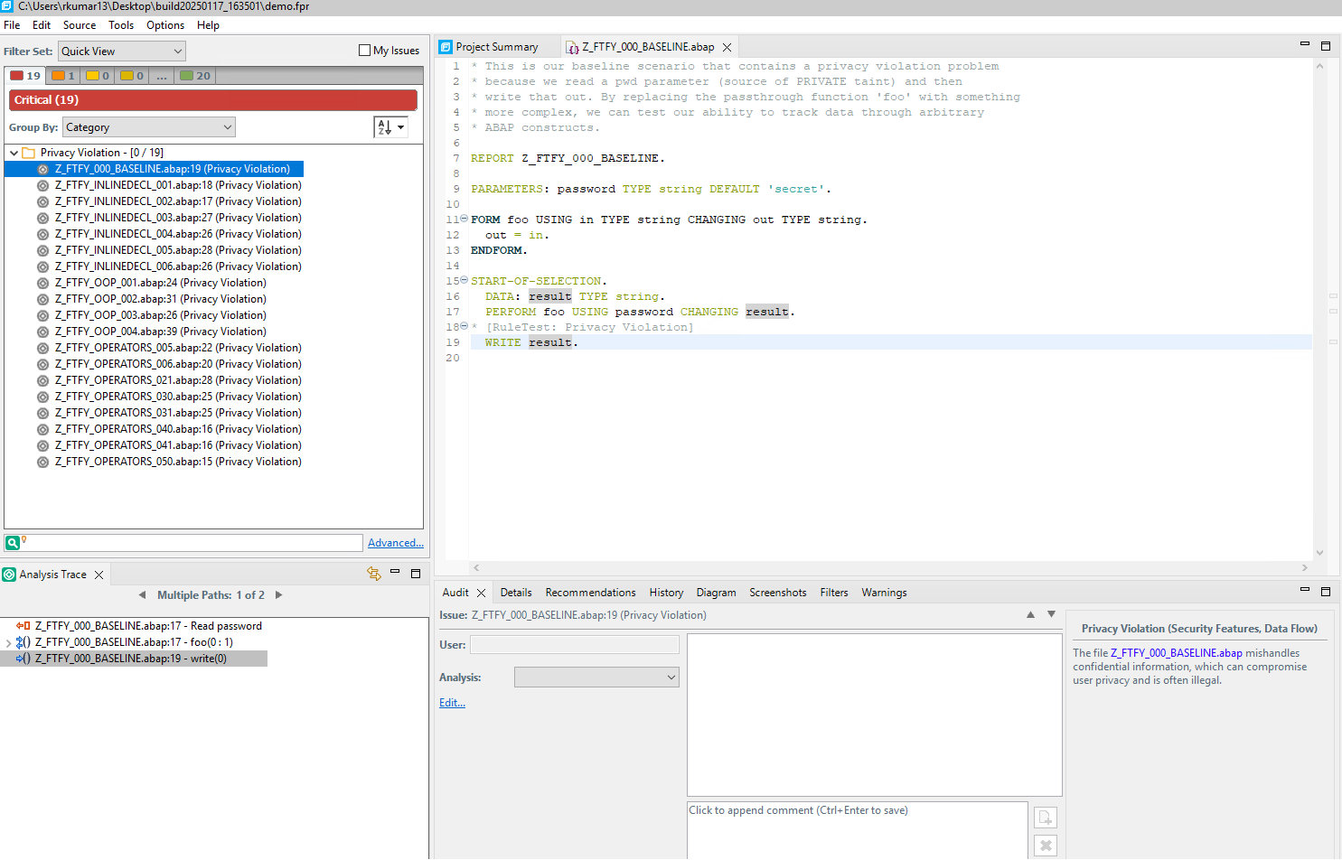
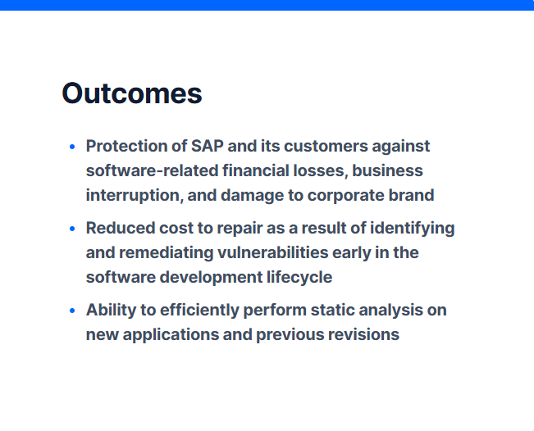
Fortify Scan ABAP – Scan Results
Notes:
https://www.microfocus.com/en-us/assets/cyberres/magic-quadrant-for-application-security-testing

Slide 7

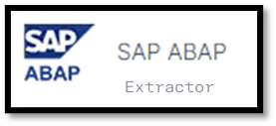
Fortify ABAP – Integration
OpenText Fortify Static Code Analyzer
OpenText Core Software Composition Analysis
OpenText Fortify On Demand
Notes:
https://www.microfocus.com/en-us/assets/cyberres/magic-quadrant-for-application-security-testing

Slide 8
Thank you
rkumar13@opentext.com

